Slide 1
Project – AI Foundation DEFCON Multiclass classification
By Dhaval Parikh

Slide 2
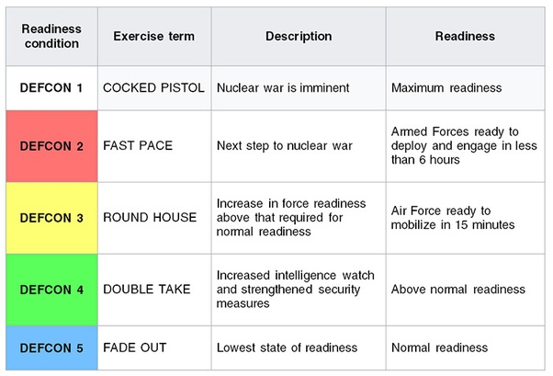
Defcon Dataset

Slide 3
Data columns and explaination
Column | Description
Allied_Nations | The number of nations that have joined together as allies.
Diplomatic_Meetings_Set | The number of meetings with the intent to resolve the conflict that is planned.
Percent_Of_Forces_Mobilized | The percentage of forces mobilized.
Hostile_Nations | The number of enemy nations that have allied together.
Active_Threats | The number of situations or threats that require immediate attention.
Inactive_Threats | The number of situations or threats being monitored for activity or escalation.
Citizen_Fear_Index | The percentage of citizens who fear catastrophic military conflicts.
Closest_Threat_Distance(km) | The closest threat to the border of the country in question.
Aircraft_Carriers_Responding | The number of aircraft carriers actively traveling towards a threat to neutralize it.
Troops_Mobilized(thousands) | The number of troops that are activated and responding to the threats being the most.
DEFCON_Level | A numeric scale of conflict 'seriousness' with 1 being the least serious and 5 being the most. (target variable)
ID | An ID to aid a checker script.

Slide 4
Approach
Approach is to check various Hyper parameters for the model
Coming up with best suitable model prediction.
How does each of the parameter affect the Model accuracy and time to fit the model.
During evaluation be on overfitting side to avoid quitting while in local minima.
Evaluate if there are any local minima
Identify the model to take as final one to evaluate and train further.

Slide 5
Conclusion
The data is not sufficient to predict the DEFCON Level as the Best accuracy is low (61.6%).
May need further feature engineering or may need to gather more data with additional features that would have better correlation with the Target variable.
Also can evaluate if the fixing of imbalance can improve the accuracy.

